Slide 1
Navy Federal Text Analysis Project
Spencer Weinstein, Yuguang Li, Yuning(Gabrielle) Gao

Slide 2
Introduction
Dataset: Navy Federal social media posts
Facebook
Twitter
Goal & Method
Sentiment analysis: Textblob & IBM
Topic mining: LDA, LSI & K-means
Trend analysis: Word2vec & Doc2vec

Slide 3
Relevance Classifier
Problem: how do we figure out which posts are worthy of further analysis?
Method : relevance classifier
Manually label a small sample of the data
Train a classifier on the manually labeled sample
Use classifier to figure out what’s important in the rest of the dataset

Slide 4
Relevance Classifier

Slide 5
Topic Mining
Next Step: Topic Mining
Use LDA and clustering methods to categorize tweets into actionable categories
Possible categories:
Transaction Delay
Can’t Access Account
Technical App/Website/Phone Issue
Password Recovery
Support/Help Request
Customer Service Complaint

Slide 6
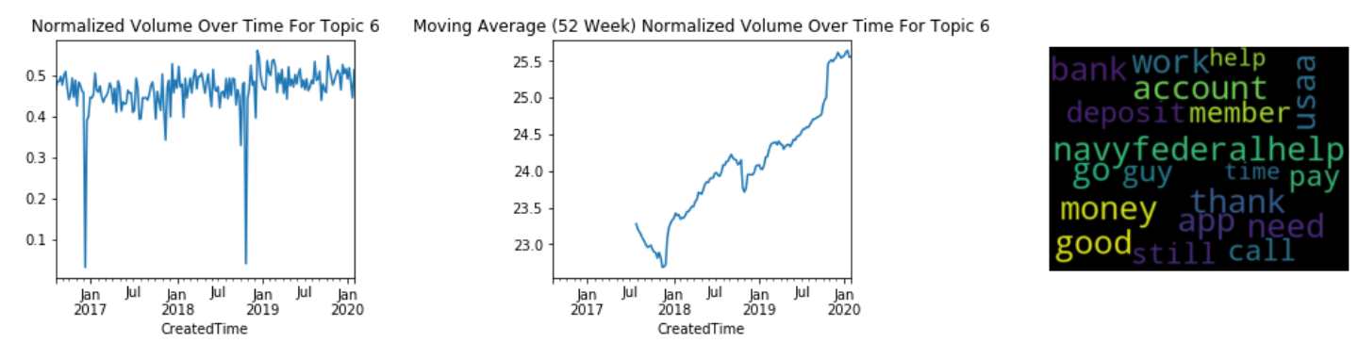
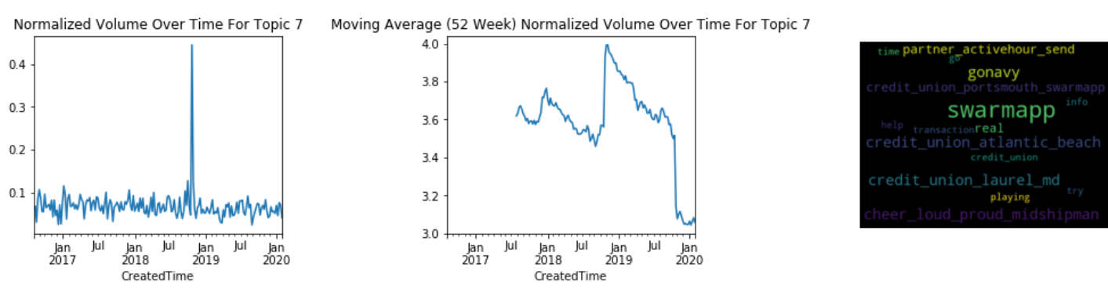

Slide 7
Topic Mining
Problem: Topics aren’t distinct
Solution:
Filter out social media campaigns (e.g. “I’m cheering loud and proud”)
Search for tweets by keyword (‘app’, ‘website’, ‘account’, ‘money’)
Search for relevant tweets using relevance classifier
Search for negative tweets using Vader/Textblob/IBM
Combine the above searches and run LDA on that
Since these are all complaints and most of them involve our keywords,
Result: LDA yields topics for customer service complaint, transaction/banking issues, and technical issues such as the app or website being down

Slide 8
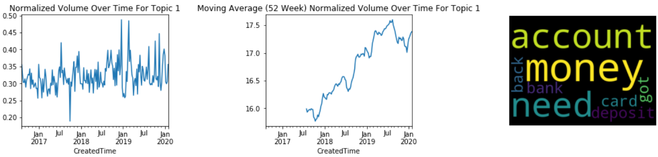
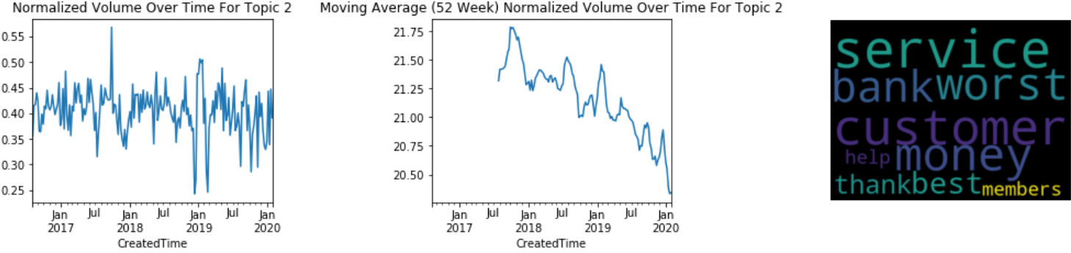
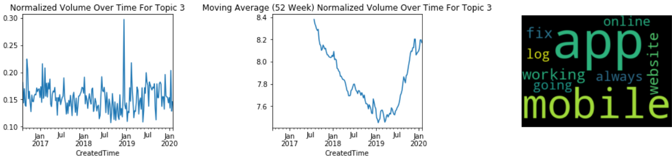

Slide 9
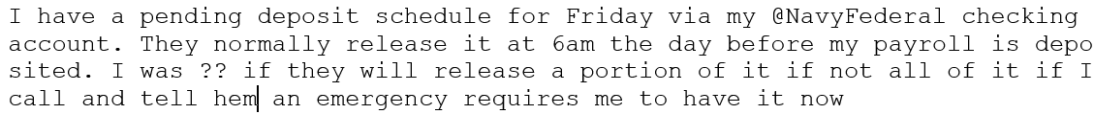
Examples of Tech/Banking Issue Tweets From LDA Topics

Slide 10
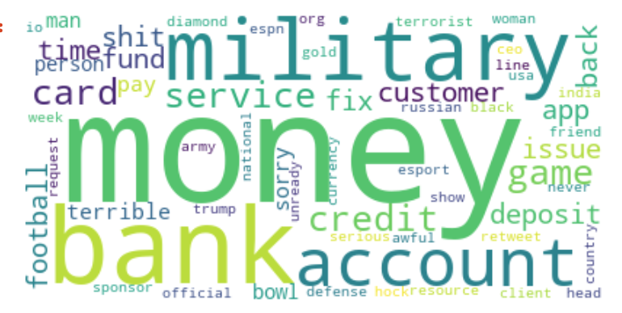
Trend Analysis - Topic
Focus on negative tweets (Polarity < 0)
Model: Latent Dirichlet Allocation (LDA)
Notes:
Gabrielle

Slide 11
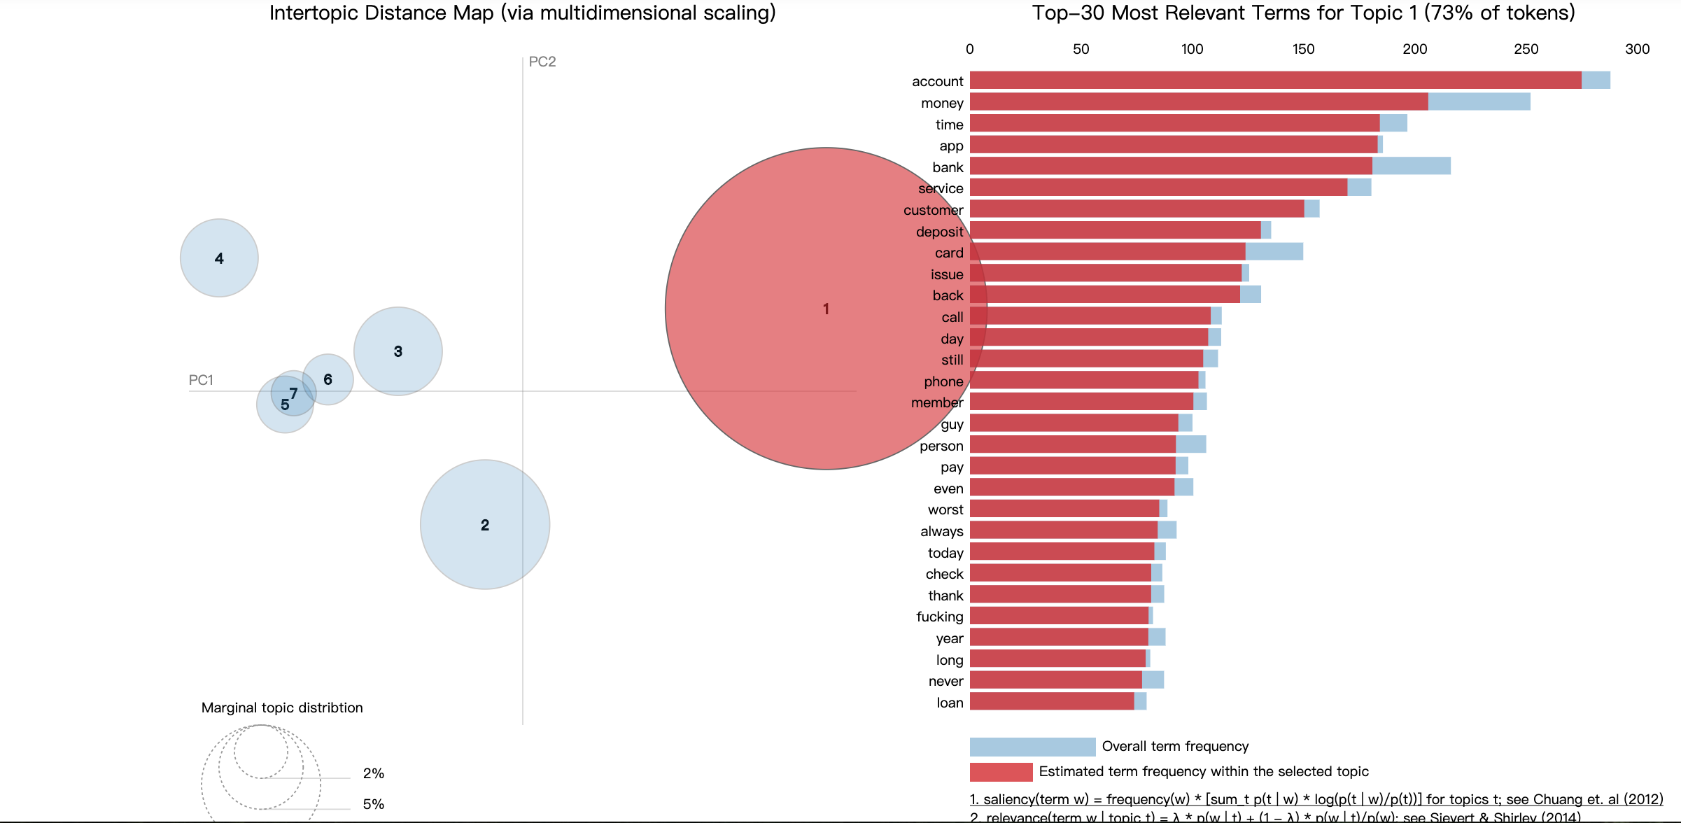
Trend Analysis - Topic
7 topic categories in total
Notes:
Gabrielle

Slide 12
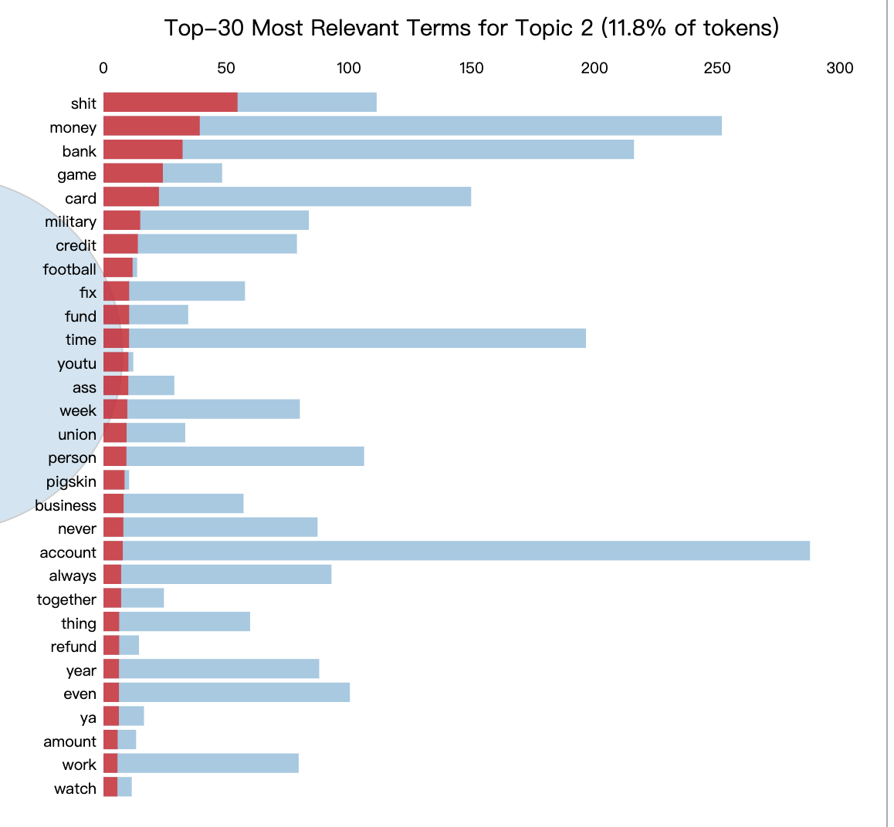
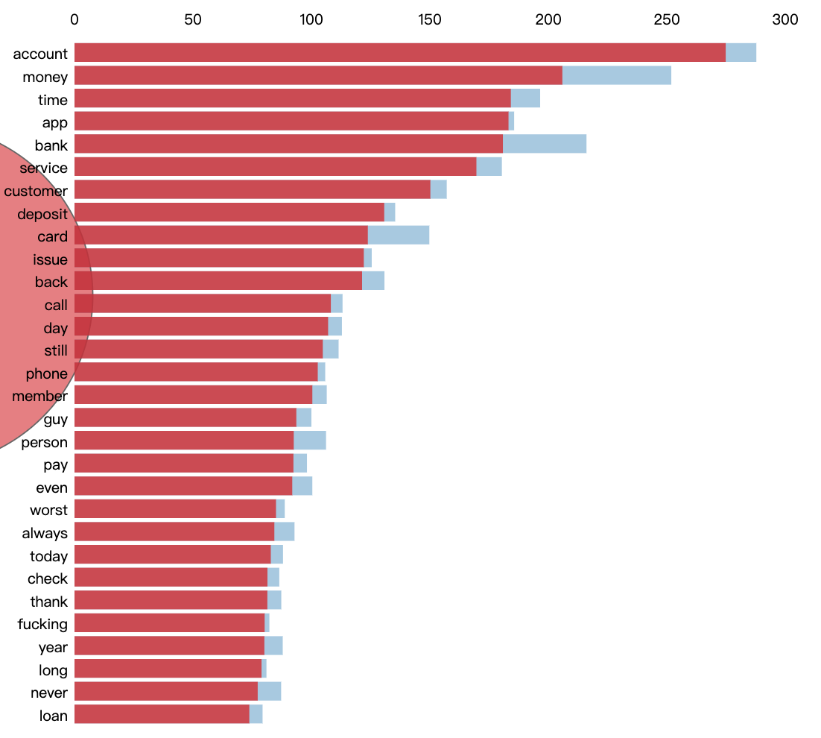
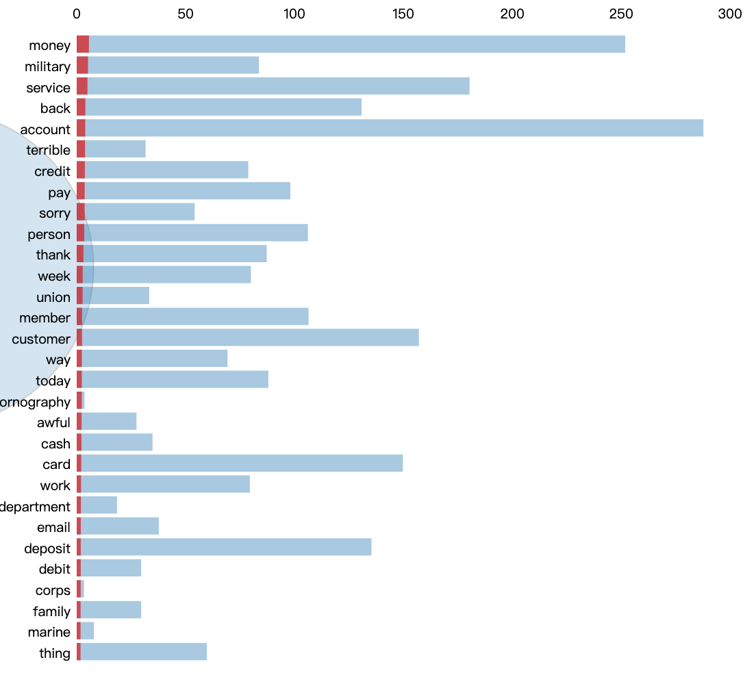
Trend Analysis - Topic
Top-30 most relevant term for each topic category
The larger the bubble, the more prevalent is that topic
Blue column -> overall term frequency
Red column -> estimated frequency with the selected topic
Notes:
Gabrielle

Slide 13
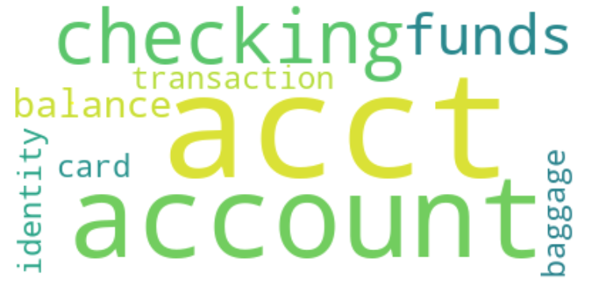
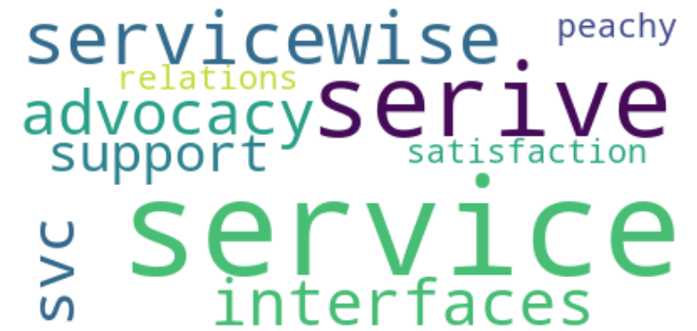
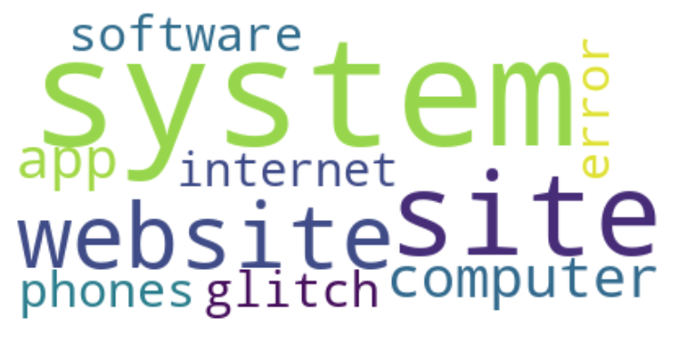
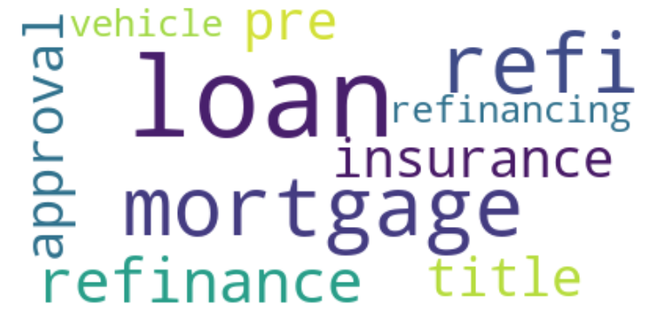
Trend Analysis - Topic & Similarity
Model: Word2vec & KeyedVectors
Soft cosine similarity: Top 10 similar words
Account/Transaction
Service
System
Loan
Notes:
Gabrielle

Slide 14
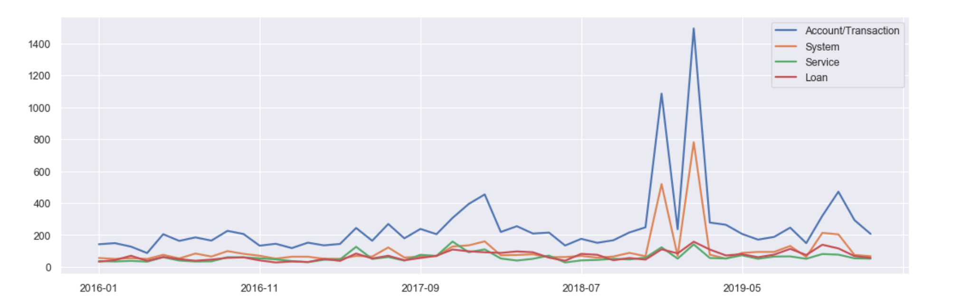
Trend Analysis - Trend over time
Notes:
Gabrielle

Slide 15
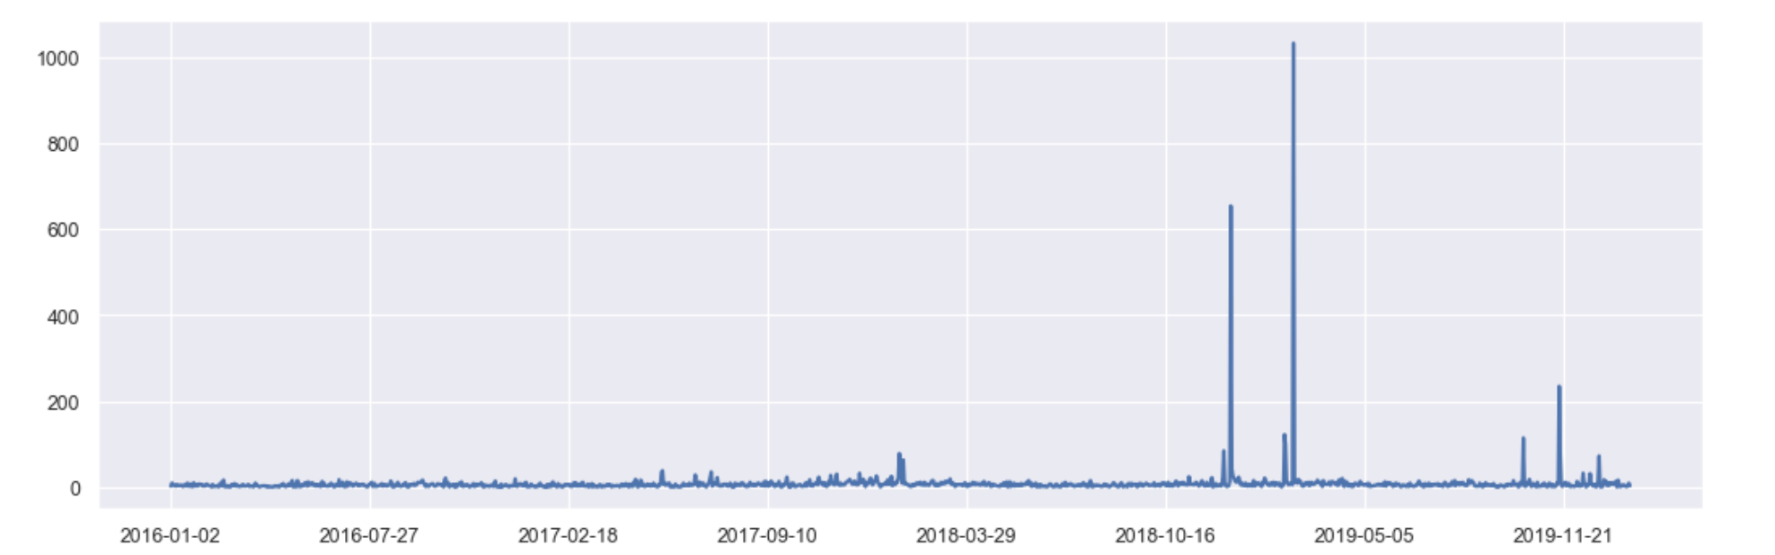
Trend Analysis - Account/Transaction
why is my bank account not showing when my money will deposit in my active duty checking when will i receive my deposit .
yeah i called and they acted dumb and told me they cannot see pending deposits even tho we are two days before getting paid biggest bs ever and i hate banking with you guys
very disappointed that you would lock my husbands account even after he proved that indeed we have moved from germany back to the usa telling him he needs to fax you a doc in the middle of a desert on christmas eve blows my mind and still no account access
is the worst you guys made a transfer by mistake and are now telling me you can only move some money back which is going to affect a closing on a home mind you it is christmas eve i hate navy federal you will have a new customer
in years i never experienced bank fraud until i joined my account has been hit twice in the last year they are the worst
Notes:
Gabrielle
Balance not correct
Deposit not show

Slide 16
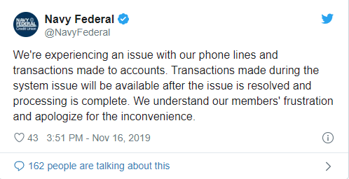
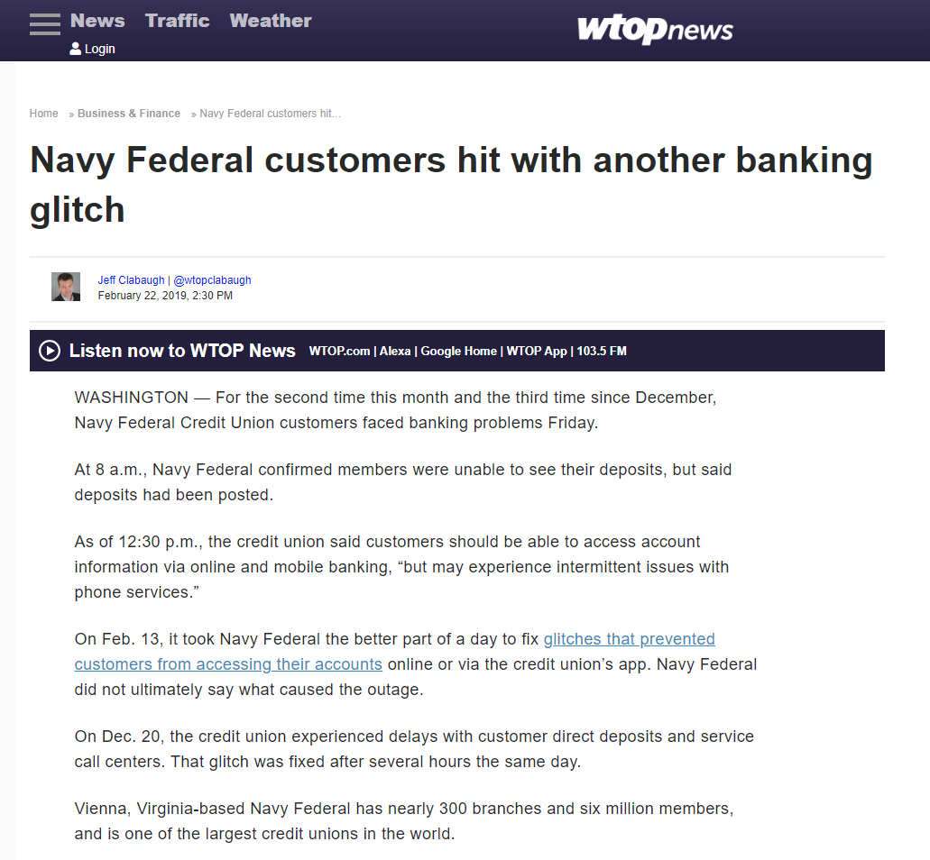
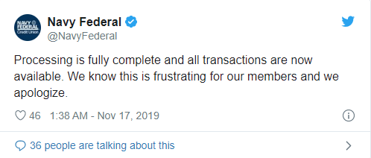
Trend Analysis - Account/Transaction
https://www.actionnewsjax.com/news/local/navy-federal-customers-frustrated-over-payment-outage/1009370143/
https://wtop.com/business-finance/2019/02/navy-federal-customers-hit-with-another-banking-glitch/
Notes:
Gabrielle

Slide 17
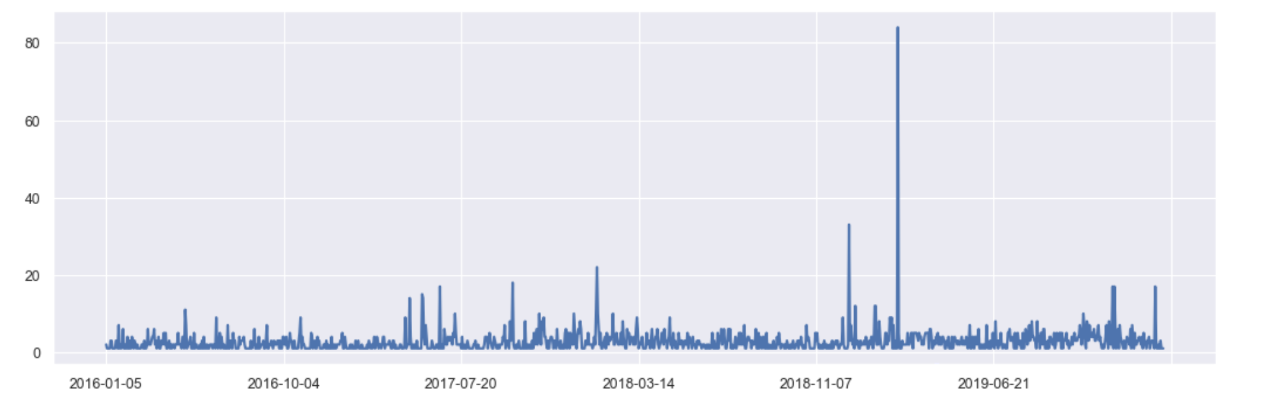
Trend Analysis - Loan
I do not trust navy fcu they stole hours of my life as their staff do not know how to help their mortgage customers the branch people cannot do anything unless the call center tells them and the call center is useless if you live in texas try randolph brooks fcu they care for their customers
you all mortgage department is ass terrible service and terrible way of handling things please contact me
she has to return the vehicle and apply for a commercial loan call them to get them to help and change loan no personal service no real help and not empathy was what we got sad
they the greatest financial institution in the land bro they do not give a fuck they give out loans and credit with low rates like water i as not never gone say nothing bad about em
Notes:
Gabrielle

Slide 18
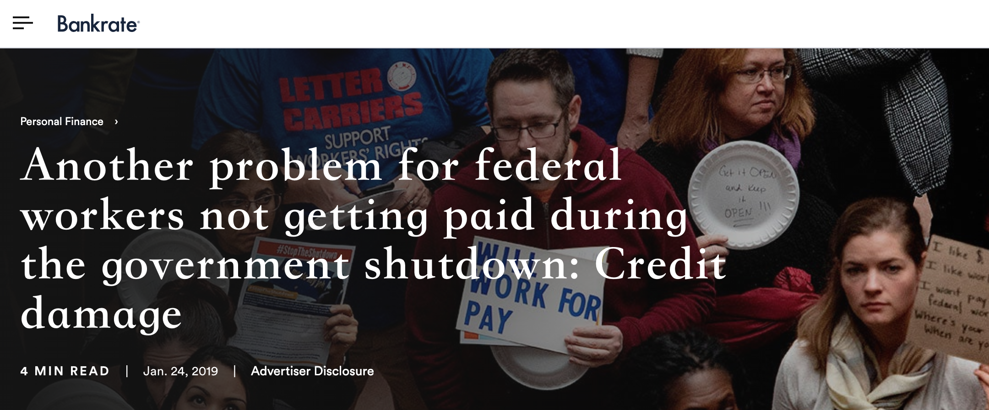
Trend Analysis - Loan
https://www.bankrate.com/personal-finance/how-to-protect-credit-during-government-shutdown/
Notes:
Gabrielle

Slide 19
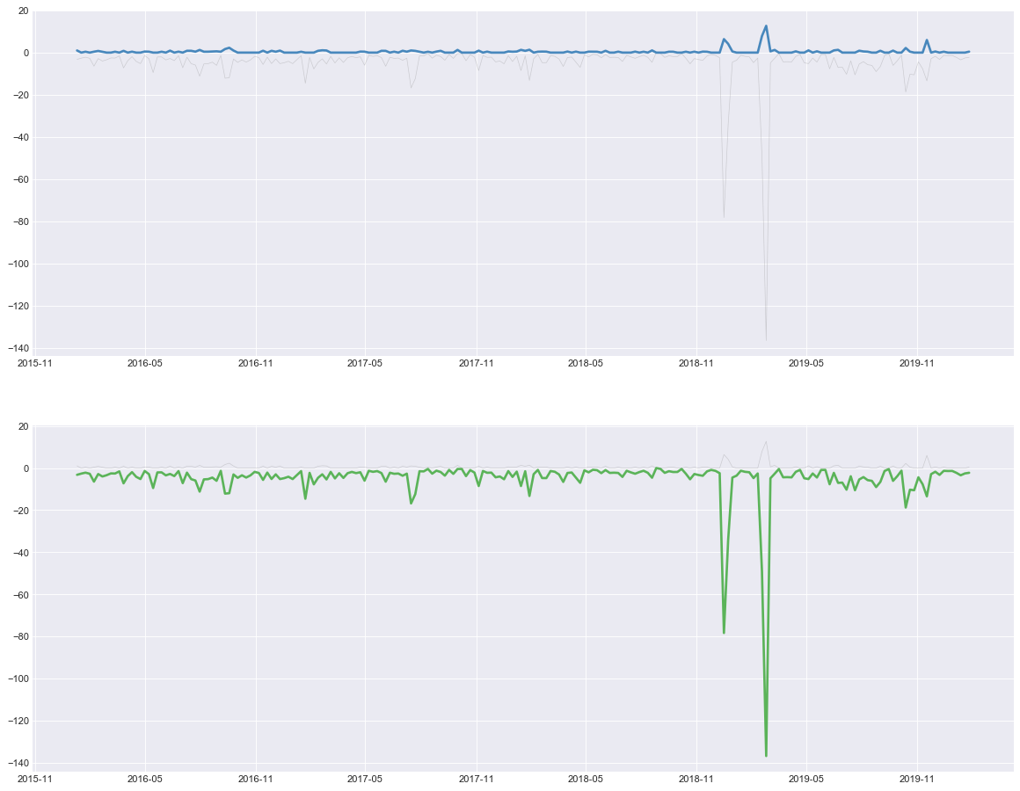
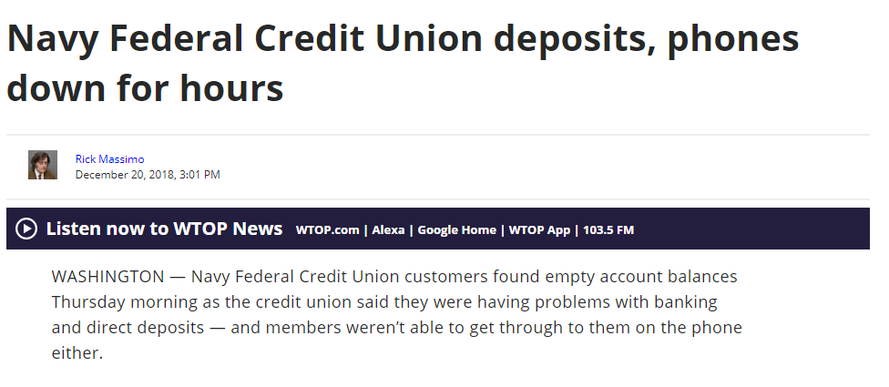
Trend Analysis - System/Tech
https://wtop.com/local/2018/12/navy-federal-credit-union-deposits-phones-are-down/

Slide 20
Trend Analysis - System/Tech
App/web down
Issue with online banking
Busy sign in
Reset password

Slide 21
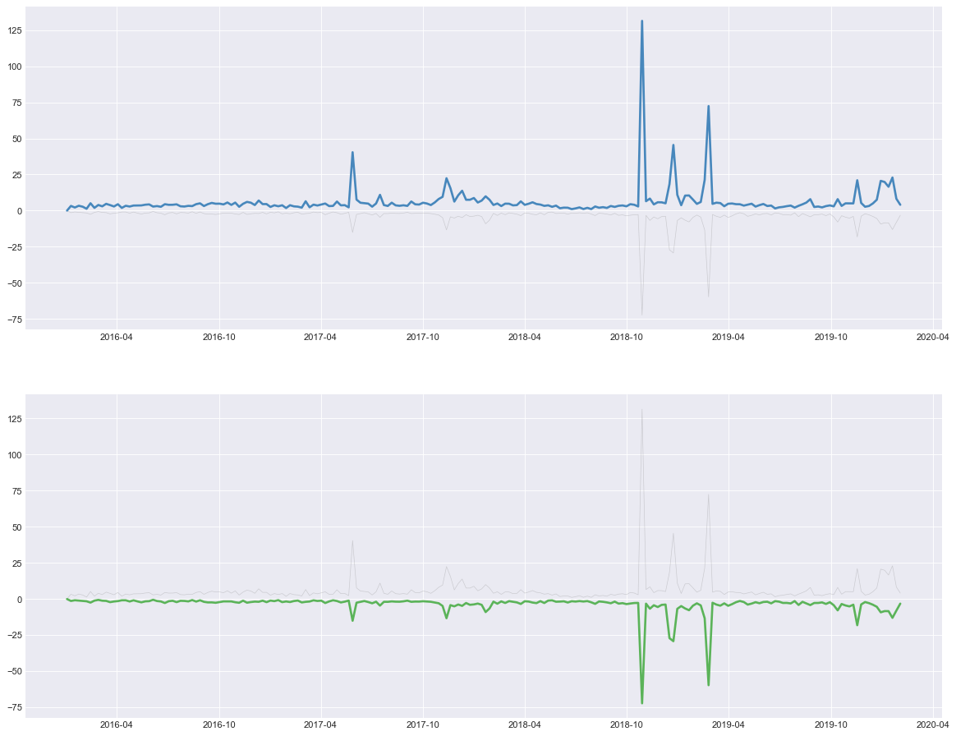
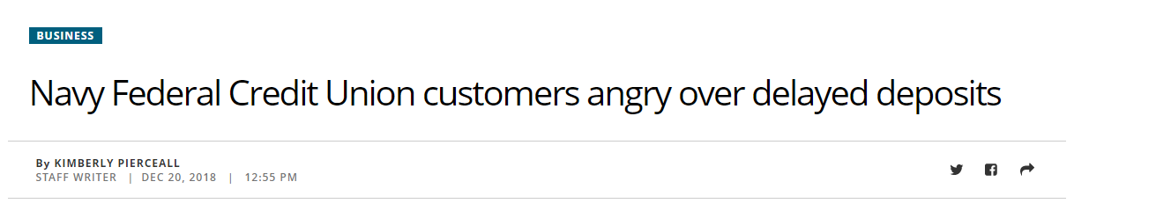
Trend Analysis - Customer Service
https://www.pilotonline.com/business/article_cb0bddf6-0479-11e9-8b36-db264a117eb2.html

Slide 22
Trend Analysis - Customer Service
Representative:
Terrible/Horrible/Poor/Rude
Thank you/Amazing
Call line busy

Slide 23
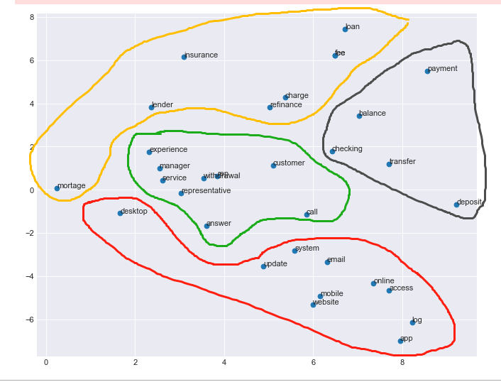
Trend Analysis - Conclusion
Clearer topics on neg posts
Positive posts are general info
Trends usually are hikes in volume in negative posts

Slide 24
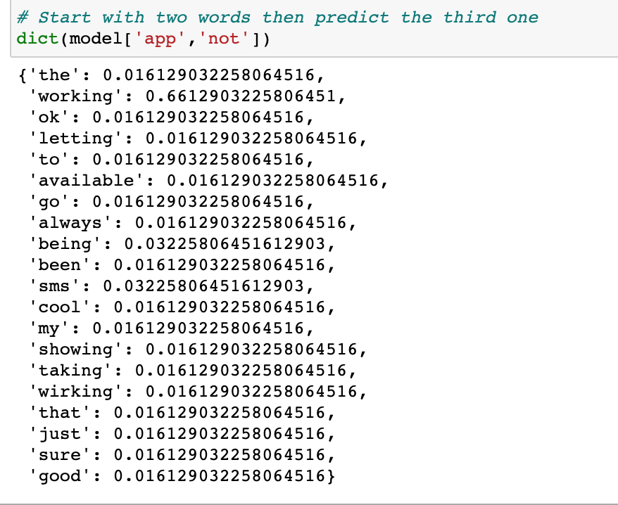
Future Work
Actionability Classifier
LDA for topic extraction
Word2vec & Soft cosine similarity for similar topics finding
Textblob for sentiment analysis (Polarity & Subjectivity)
Trigram for social media posts extraction
Results:
app not working and tells me to the app and signing in and add more atm in my face and come back and i feel very trapped being a member since
app not working for me
phone line they are trash
app down i need to close always close the account that i really do miss the sweepstakes on the regular website i am some irate individual who was wounded during his inspirational get busy and she cold blooded said nope we use for mine now a lot of the perceived added security
customer service representatives and it keeps glitching when i dialed the phone
Notes:
Gabrielle

Slide 25
Future Work
Automated topic generation and classification through doc2vec
Can automatically identify topics through clustering
Drawback: requires a lot of training time and a much larger dataset
Lda2vec
Topic mining algorithm that combines elements of w2v and LDA
Learns word vectors along with document-topic distributions
LabeledLDA
Semi-supervised LDA algorithm that builds topics based on seed words

Slide 26
Thank you !
Question?

